Slide 1
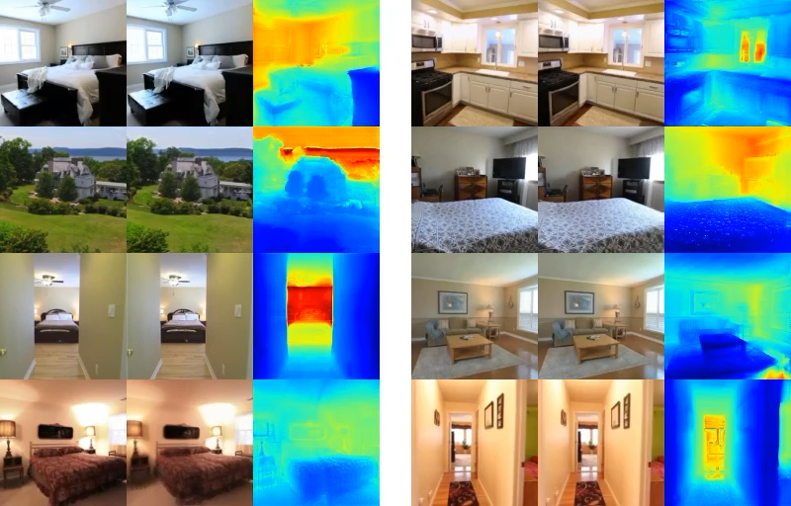
Input Image
RGB Renderings
Depth Renderings
Input Image
RGB Renderings
Depth Renderings

